Slide 1
KISAN BUDDY
PIP2001 University Project-II
Final Viva-Voce
Batch Number: CSE-G134
Roll Number | Student Name
Under the Supervision of,
Dr. Vairavel Chenniyappan
Assistant Professor
School of Computer Science & Engineering
Presidency University
20211CSE0784 | Mohammed Ismail
20211CSE0783 | Shaik Akram
20211CSE0762 | Bandi Raghavendra

Slide 2
Introduction
Kisan Buddy is an innovative mobile application designed to empower farmers by providing real-time mandi price updates, profitability recommendations, and navigation support. The app simplifies decision-making for farmers, helping them choose the best market to sell their crops based on profit analysis.
Built using cutting-edge technologies like Firebase Realtime Database, Fire store, and Google Maps integration, Kisan Buddy ensures seamless access to critical data while maintaining a user-friendly interface tailored for farmers. By addressing challenges like market accessibility and information gaps, Kisan Buddy aims to enhance agricultural productivity, profitability, and overall livelihood for farmers.

Slide 3
Literature Review
Agarwalla (2015) explores the development of the Kisan Network, a digital platform connecting farmers directly to buyers, eliminating intermediaries. This study emphasizes the role of technology in empowering farmers by providing direct market access and increasing profitability.
Mohan et al. (2024) present the Farmers Buddy app, an online platform enabling farmers to sell their produce directly to consumers. The app incorporates features like crop management, profitability analysis, and market price updates.
Prof. Gorde et al. (2024) introduce the Farmer Application, which provides crop recommendations, market price insights, and financial forecasts. The study underscores the importance of integrating real-time data analytics to assist farmers in making informed decisions.

Slide 4
Literature Review
Nimje and Wankhede (2019) focus on the Farmer Buddy app, which provides services like crop scheduling, mandi price updates, and agricultural tips. The study emphasizes the importance of accessibility and user-friendly design, particularly for farmers in rural areas.
Kambale et al. (2024) provide an overview of existing agricultural apps and their role in improving farmers' efficiency and productivity. The authors highlight the benefits of features like market price updates, weather forecasting, and crop advisory.
Saraf et al. (2022) explore the role of Firebase as a backend service for mobile app development. Firebase’s features, including real-time database, authentication, and scalability, are well-suited for agricultural apps. The study emphasizes its ability to streamline app development and improve performance.

Slide 5
Research Gaps Identified
Localized Content: Most applications lack support for local languages and regional contexts, making it harder for farmers to use them effectively.
Profitability Analysis: There are limited tools to help farmers calculate real-time profitability, which is crucial for decision-making.
Navigation Services: Geolocation and navigation features, such as finding nearby mandis (markets), are underdeveloped in many apps.
Technological Literacy: Many farmers face challenges in understanding and using apps due to their limited knowledge of technology.
Integration of Features: Existing apps often focus on isolated features (e.g., crop advisory, weather updates) rather than providing a comprehensive solution.
Data Accuracy: Some apps lack accurate real-time data for pricing, weather, or mandi availability, which reduces their reliability.

Slide 6
Proposed Methodology
System Design: The system is structured into modular components, ensuring scalability and efficiency. It uses a Model-View-Controller (MVC) architecture to separate data, UI, and logic.
Data Collection and Processing: Mandi price data is sourced from the Open Government Data (OGD) Platform India and stored in Fire store for seamless access and real-time updates.
User Authentication: Firebase Authentication manages secure login and registration using email and password. User credentials and profiles are stored in the Realtime Database.
Front-End Implementation Developed using Android Studio, the app employs Material Design principles for a user-friendly interface. Features include dynamic filtering, sorting, and history tracking tailored for farmers.
Backend Implementation
Firebase Realtime Database: Stores user-specific data like profiles and crop details, enabling real-time synchronization across devices.
Firebase Firestore: Hosts mandi data for efficient retrieval and querying.
SharedPreferences: Saves recent mandi recommendations locally for quick access, even offline.
Custom algorithms process mandi data and calculate profitability, ensuring seamless integration between the app and databases.

Slide 7
Proposed Methodology
6. Recommendation Engine: Profitability is calculated using the formula: Profit = (Mandi Price − User Crop Cost) × Quantity The app ranks mandis based on potential profit, enabling farmers to make informed decisions.
7. Navigation and Accessibility: Google Maps integration provides turn-by-turn navigation to selected mandis, addressing logistical challenges.

Slide 8
Objectives
Provide Real-Time Mandi Price Information: Enable farmers to access accurate and up-to-date prices for crops across various mandis.
Facilitate Data-Driven Decision-Making: Assist farmers in making informed choices by analyzing mandi prices, crop costs, and profitability.
Simplify Profitability Computation: Automate profit calculations to help farmers identify the most profitable mandis efficiently.
Integrate Seamless Navigation Services: Use Google Maps for real-time directions to mandis, minimizing transportation challenges.
Maintain Historical Data: Store and display past recommendations to track trends and assist in future decision-making.

Slide 9
System Design & Implementation
Architecture
Based on the Model-View-Controller (MVC) pattern for clear separation of concerns.
Integrates Firebase services for backend support, ensuring scalability and real-time synchronization.
Front-End Design
Built using Android Studio with Material Design principles for a modern and user-friendly interface.
Includes intuitive screens for Login, Registration, Dashboard, and Mandi Recommendations.
Back-End Design
Firebase Authentication ensures secure user login and registration.
Firebase Realtime Database stores user data and transaction history.
Firestore handles mandi price data and updates for seamless integration.

Slide 10
System Design & Implementation
4. Core Functionalities
Mandi Recommendations: Identifies the most profitable mandis using crop cost and quantity inputs.
Navigation Integration: Real-time directions to mandis using Google Maps.
History Tracking: Maintains past mandi searches and recommendations for user reference.
5. Workflow
Users authenticate via email/password.
Input crop details, cost, and quantity to fetch recommendations.
Access features like real-time mandi prices, profit computation, and navigation.
Testing and Optimization
Comprehensive testing was conducted to ensure functionality, performance, and usability.

Slide 11
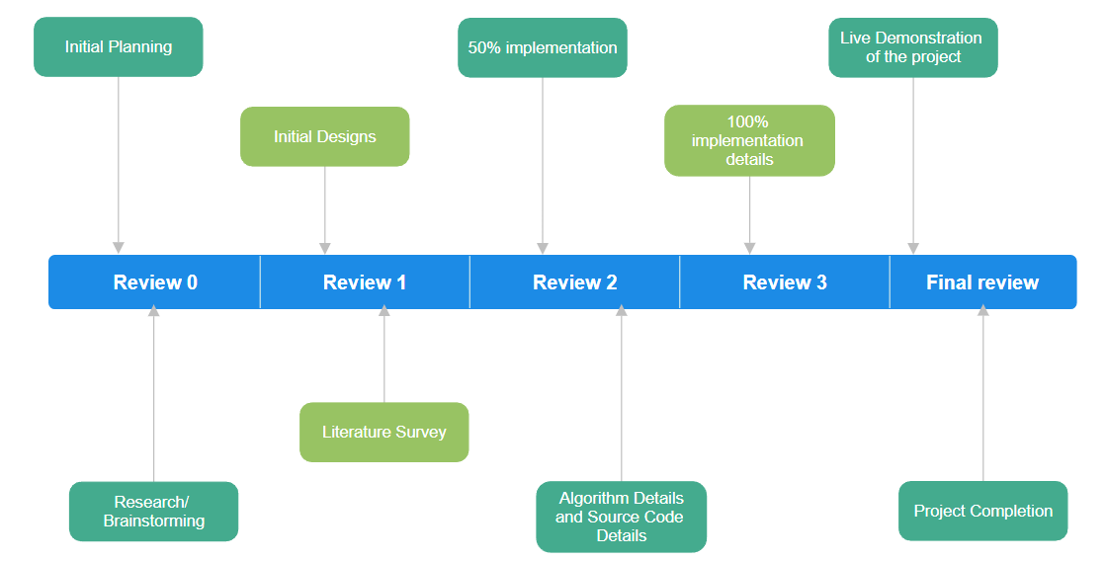
Timeline of Project

Slide 12
Outcomes
Real-Time Access to Mandi Prices
Farmers gain access to accurate, up-to-date mandi price information for better market insights.
Improved Decision-Making
Data-driven recommendations empower farmers to maximize earnings and reduce risks.
Enhanced Navigation
Integration with Google Maps allows seamless navigation to the most profitable and nearby mandis.
User-Friendly Interface
Intuitive design tailored for farmers ensures ease of use, even for users with minimal technical expertise.
Scalable and Secure
Built on Firebase, ensuring scalability for future enhancements and robust security for user data.

Slide 13
Conclusion
The Kisan Buddy project successfully addresses the challenges faced by Indian farmers in accessing reliable mandi information and maximizing profitability.
By leveraging technologies such as Firebase, Android, and Google Maps, the app provides real-time price updates, efficient navigation, and personalized recommendations.
Its farmer-centric design ensures accessibility and usability for all. Kisan Buddy not only enhances decision-making but also fosters economic growth in rural communities, paving the way for a more informed and empowered farming ecosystem.

Slide 14
References
Agarwalla, A. (2015). Independent work report: Kisan Network (Hindi for “Farmer Network”). Princeton University, Department of Computer Science. Retrieved from https://www.cs.princeton.edu/~rdondero/iw/15Agarwalla.pdf
Haseemun, P., & Somasekhar, K. (2019). A study of Farmers Buddy app development. International Journal of Computer Sciences and Engineering, 7(Special Issue 6), 173–175. https://doi.org/10.26438/ijcse/v7si6.173175
Kambale, P., Dharma Raj, B. M., Patil, D., & Ganavi, N. R. (2024). Mobile technology for farmers: An overview of agricultural apps. Asian Journal of Agricultural Extension, Economics & Sociology, 42(9), 75–81. https://doi.org/10.9734/ajaees/2024/v42i92543
Khawas, C., & Shah, P. (2018). Application of Firebase in Android app development: A study. International Journal of Computer Applications. https://doi.org/10.5120/ijca2018917200
Kumari, D. (2022). A study of agriculture-related mobile apps and its impact on farming system. DDU Gorakhpur University. IJCRT, 10(2). https://ijcrt.org/papers/IJCRT2202239.pdf
Mohan, C. R., Kumar, C. S., Chowdary, K. L. N., Ganesh, K. V. S., & Narahari, C. V. (2024). Farmers Buddy: Farmers Online Selling Application. International Journal of Research in Engineering, IT and Social Sciences, 14(06), 29–37. Retrieved from https://www.indusedu.org/pdfs/IJREISS/IJREISS_4234_61801.pdf
Nimje, M., & Wankhede, P. (2019). Farmer Buddy. In R. Babu (Ed.), National Conference on "Recent Advances in Engineering and Technology" (SAMMANTRANA 19) (Vol. 4, No. 8). International Journal of Innovations in Engineering and Science. Retrieved from https://www.ijies.net/finial-docs/finial-pdf/220519CS10.pdf
Oteyo, I.N., Marra, M., Kimani, S. et al. A Survey on Mobile Applications for Smart Agriculture. SN COMPUT. SCI. 2, 293 (2021). https://doi.org/10.1007/s42979-021-00700-x
Prof., Gorde, Vaishali, S.., Bidgar, Gaurav, D.., Pangavhane, Kalyani, K.., Shinde, Pranali, S.., Jeughale, Ashish, M.. (2024). Farmer Application. International Journal of Advanced Research in Science, Communication and Technology, doi: 10.48175/ijarsct-17280
Saraf, P. R., Jadhao, S. M., Wanjari, S. J., Kolwate, S. G., & Patil, A. D. (2022). A review on Firebase (Backend as a Service) for mobile application development. International Journal for Research in Applied Science & Engineering Technology (IJRASET, 10(1), 967–973. Retrieved from https://www.ijraset.com/best-journal/firebase-backend-as-a-service-for-mobile-application-development

Slide 15
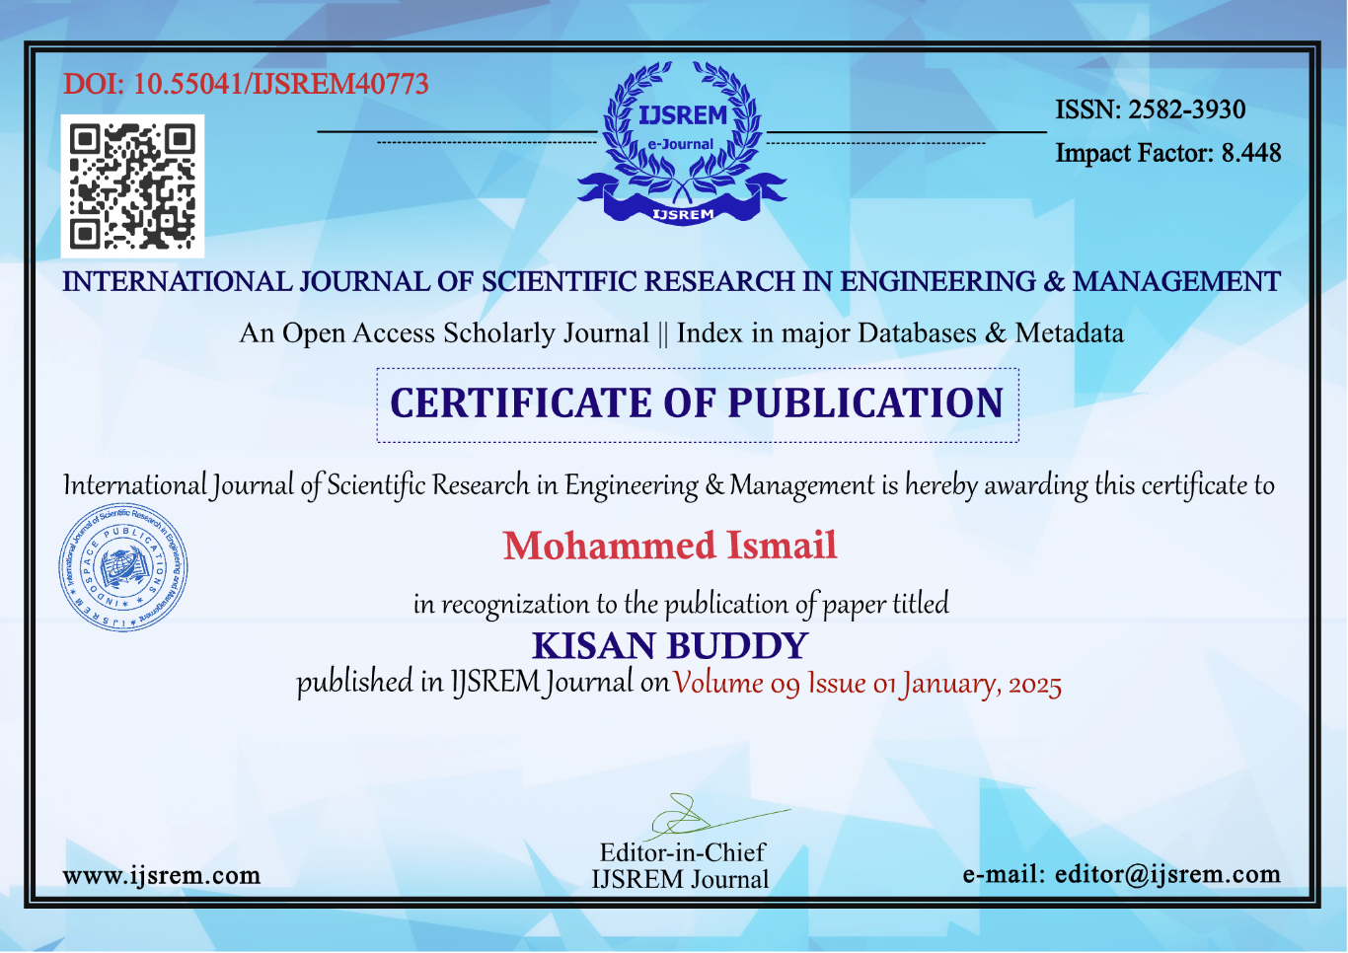
Publication Details

Slide 16
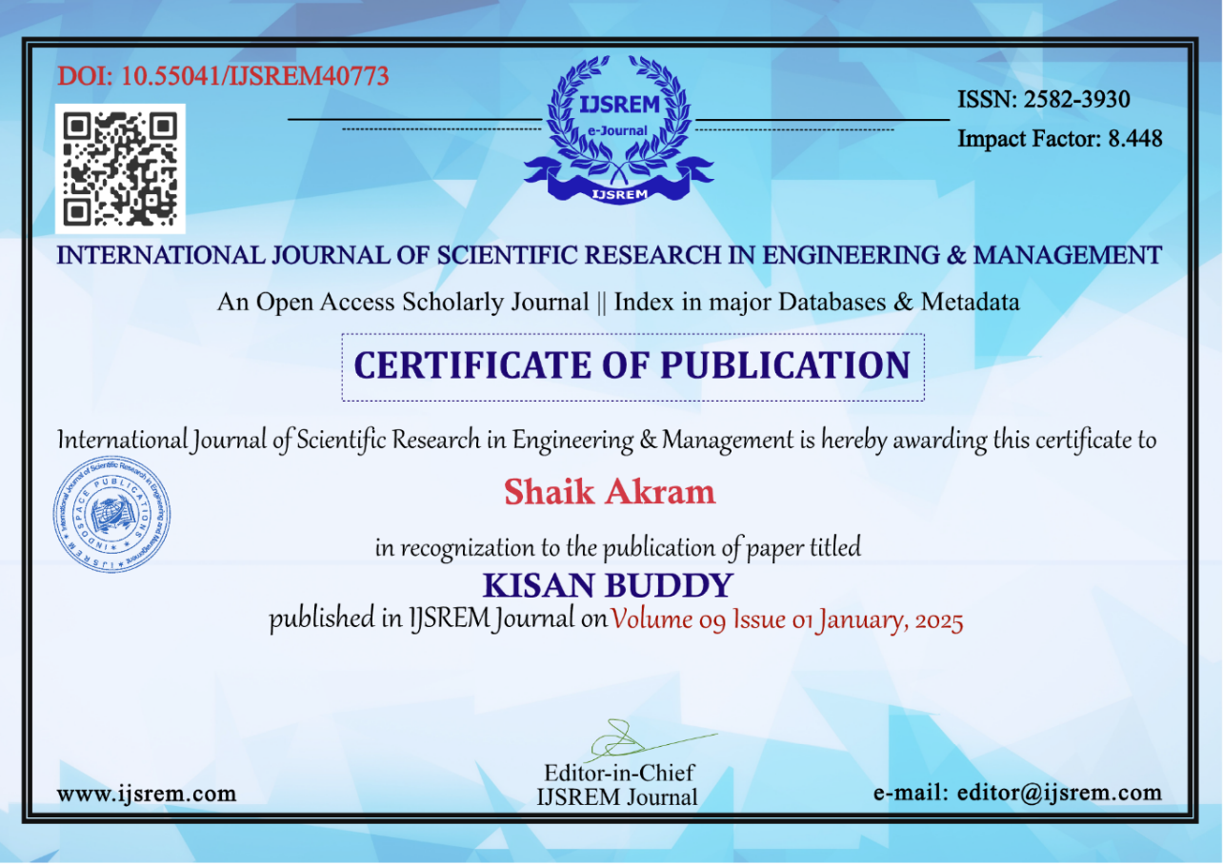

Publication Details

Slide 17
Thank You

